Slide 1
Introduction to Computer Vision
Presented by Souvik Ghosh

Slide 2
Learning Objectives
What is Computer Vision?
Applications of Computer Vision.
How Computer Vision works?
Introduction to OpenCV.
Face Detection Algorithm.

Slide 3
Task to be done
Face Detection in images using Dlib

Slide 4
What is Computer Vision?
Computer Vision is the field of study focused on the problem of helping computers to see.
Thus, the goal is to write programs that can interpret images.
The image data can take many forms such as video sequence, depth images, views from multiple cameras etc.

Slide 5
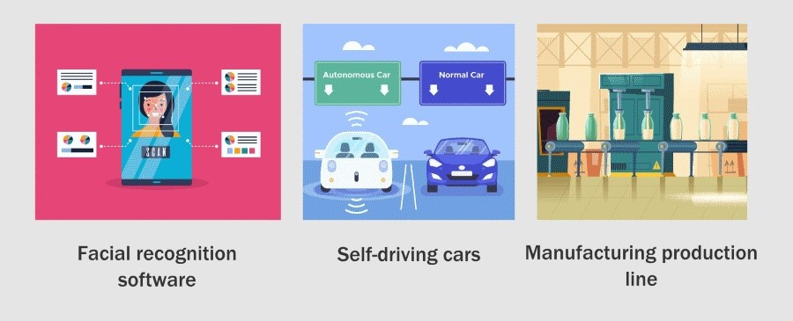
Applications of Computer Vision

Slide 6
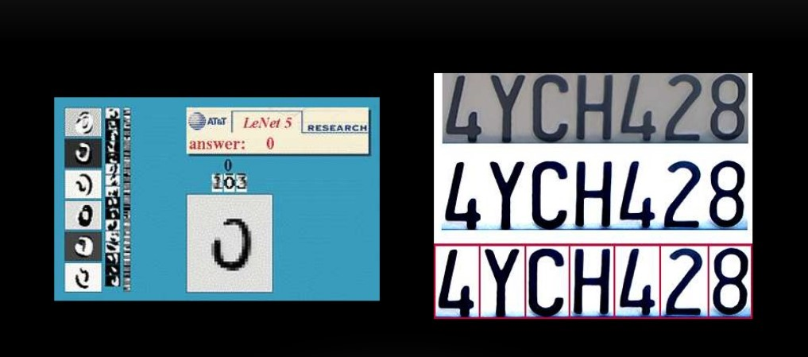
Optical Character Recognition (OCR)

Slide 7
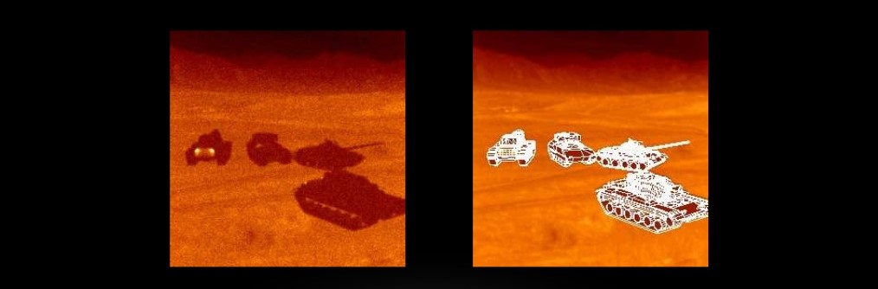
Target Recognition
Left: Original Image(in night vision) Right: Targets recognized and segmented

Slide 8
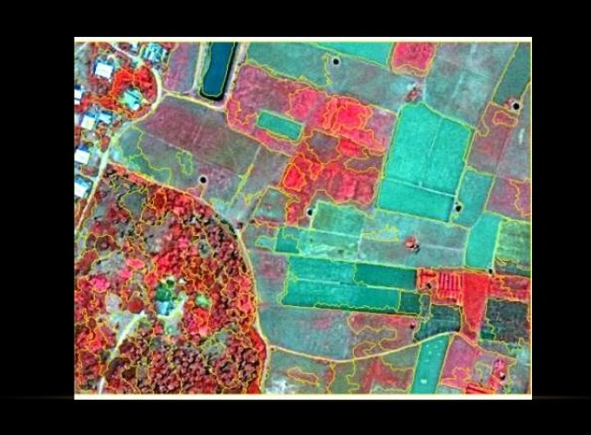
Interpretation of Satellite Images
Segmenting out roads, fields, water bodies, etc.

Slide 9
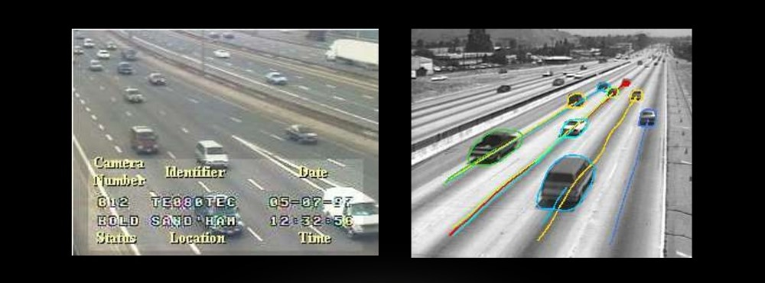
Traffic Monitoring

Slide 10
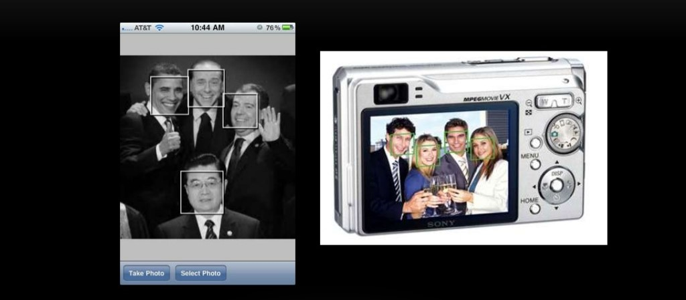
Face Detection

Slide 11
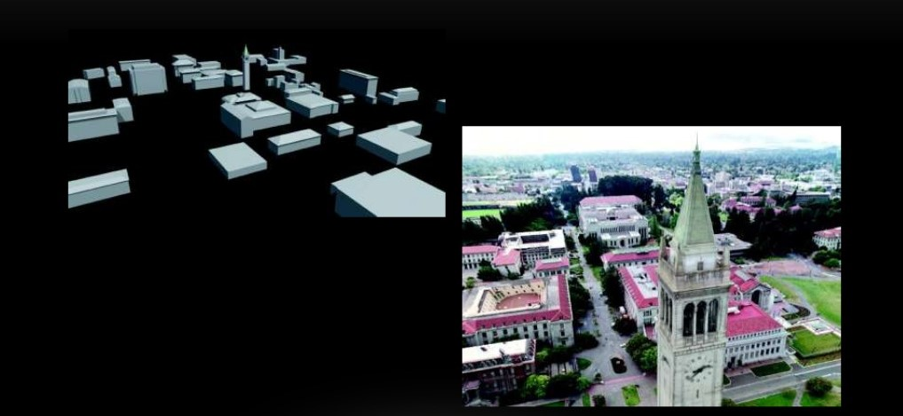
3D Shape Reconstruction

Slide 12
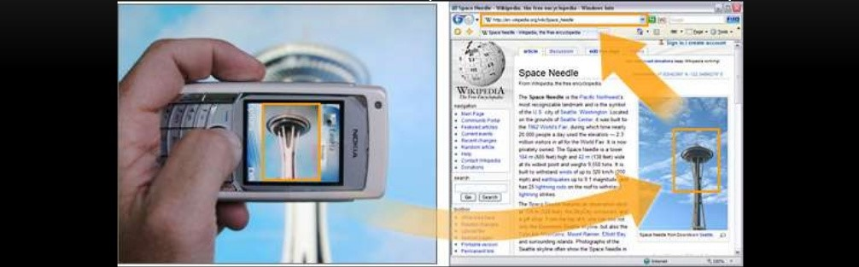
Object Recognition

Slide 13
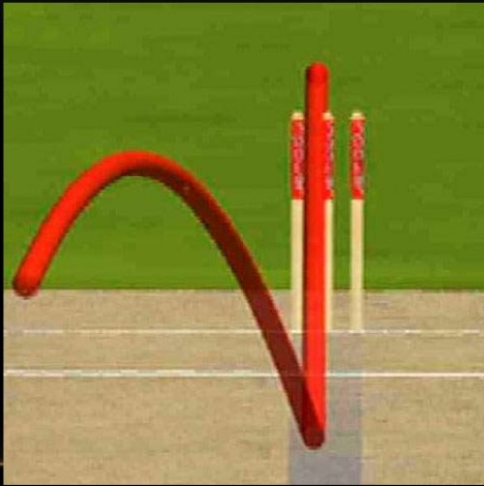
Sports
Hawk Eye Representation

Slide 14
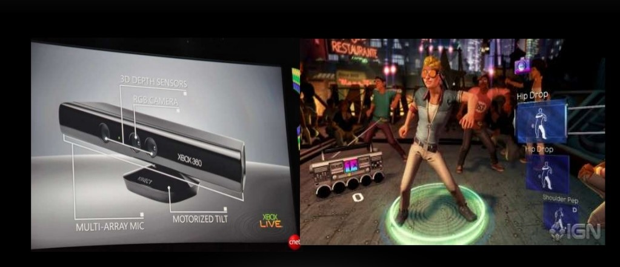
Interactive Games

Slide 15
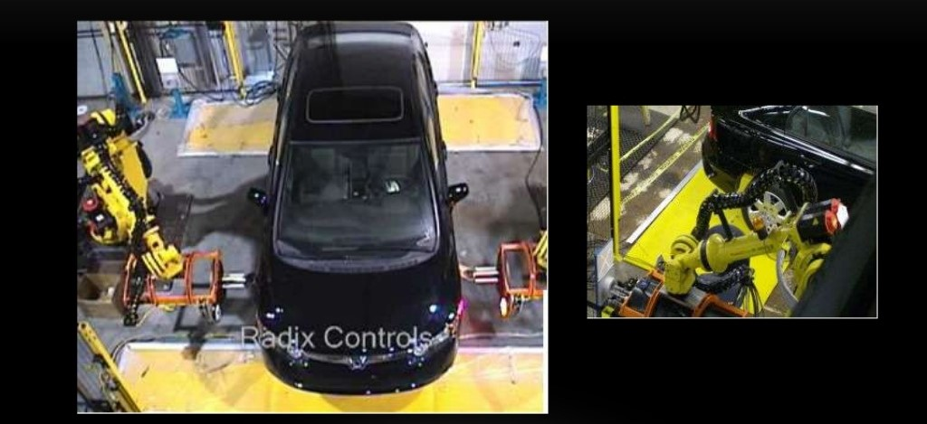
Industrial Robots

Slide 16
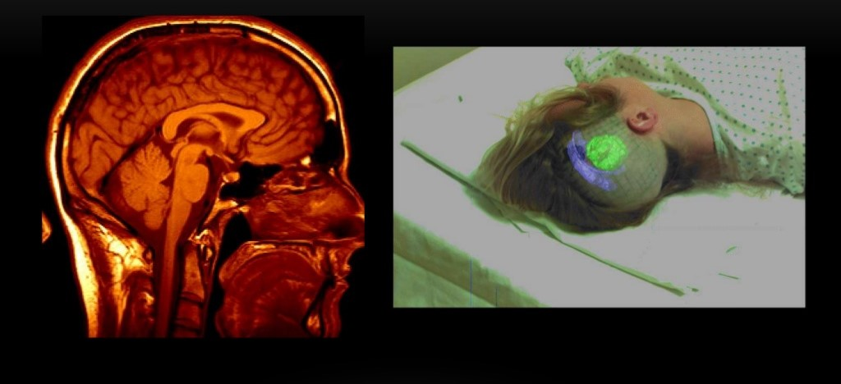
Medical Imaging

Slide 17
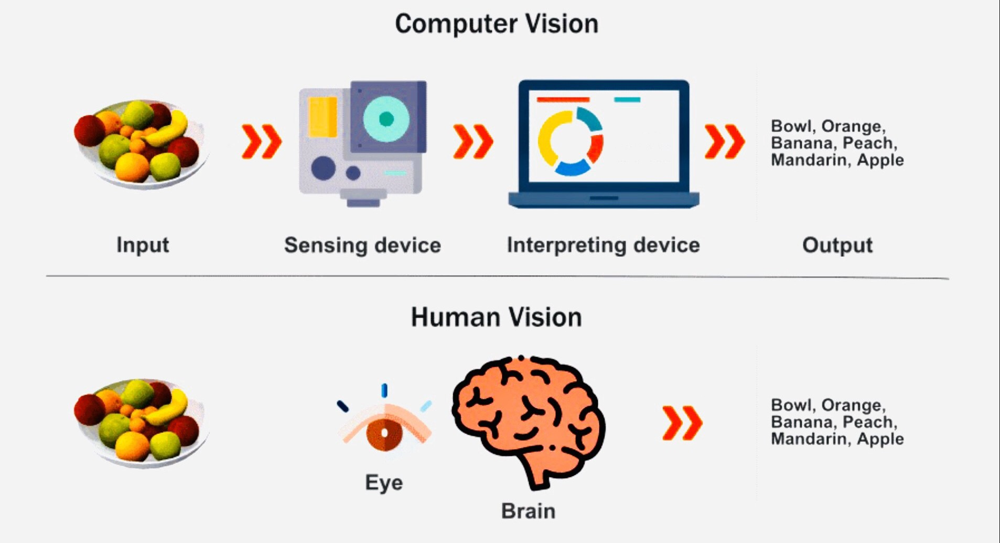
How Computer Vision works?

Slide 18
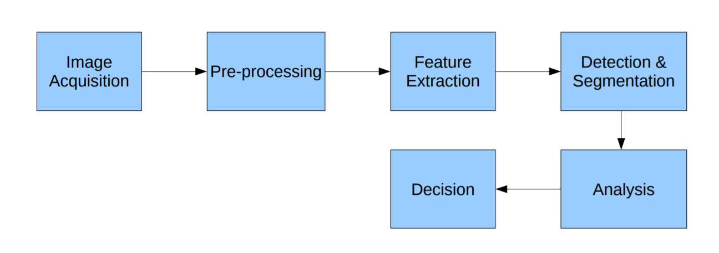
Computer Vision System methods
Image Acquisition
Pre-processing
Feature Extraction
Detection and Segmentation
Analysis
Decision

Slide 19
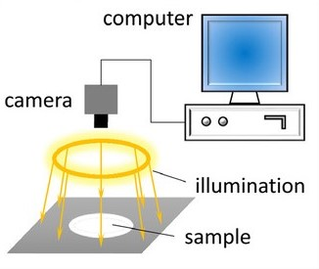
Image Acquisition
Getting images from various sources like camera feed, video or images.

Slide 20
Pre-Processing
Re-sampling in order to assure that the image co-ordinate system is correct.
Noise reduction in order to ensure that the sensor doesn’t introduce any false noises.
Contrast enhancement in order to ensure that relevant information can be detected.

Slide 21
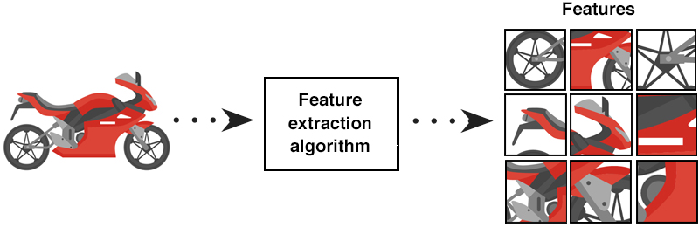
Feature Extraction
Lines, edges and ridges.
Localized interest points like corners, blobs or points.
More complex features maybe related to texture, shape or motion.

Slide 22
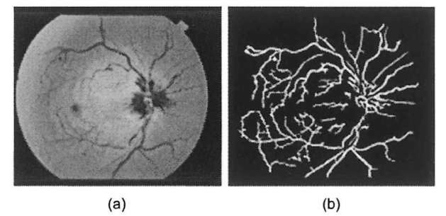
Detection and Segmentation
At some point in the processing a decision is made about which image points or regions of the image are relevant for further processing.
Selection of a specific set of interest points.
Segmentation of one or multiple image regions which contain a specific object of interest.

Slide 23
Analysis
Verification that the data satisfy model-based and application specific assumptions.
Image recognition: classifying a detected object into different categories.
Image registration: comparing and combining two different views of the same object.

Slide 24
Decision
Pass/fail on automatic inspection applications.
Match / no-match in recognition applications.
Flag for further human review in medical, military, security and recognition applications.

Slide 25
Continued
Since, we will do an exercise on Face Detection, so we will cover some details about how Face Detection Algorithm works, but before that we will talk a little bit about OpenCV.

Slide 26




What is OpenCV?
It is a cross-platform library using which we can develop real-time Computer Vision applications.
It is open-sourced and available freely for academic and commercial use.
It is a highly optimized library with focus on real-time applications.
It has C++, Java, Python and MATLAB interfaces support.
It was written natively on C++.

Slide 27
Why OpenCV?
The library has more than 2500 optimized algorithms.
Faster Processing Time.
Easy to use and understand.
Cross Platform.
Notes:
to detect and recognize faces, identify objects, classify human actions in videos, track camera movements, track moving objects, extract 3D models of objects, produce 3D point clouds from stereo cameras, stitch images together to produce a high resolution image of an entire scene, find similar images from an image database, remove red eyes from images taken using flash, follow eye movements, recognize scenery and establish markers to overlay it with augmented reality, etc.

Slide 28
Continued
Since, now we know about the OpenCV library and its uses, we will now proceed towards Face Detection Algorithms.

Slide 29
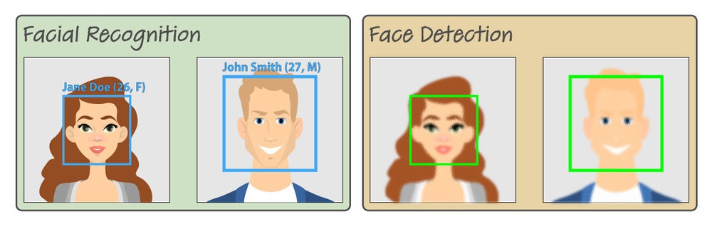
Face Detection vs Face Recognition
Face detection just means that a system is able to identify that there is a human face present in an image or video. Face recognition can confirm identity.

Slide 30
Face Detection using Dlib
dlib is a toolkit for making real world machine learning and data analysis applications in C++.
While the library is originally written in C++, it has good, easy to use Python bindings.
dlib has an inbuilt H.O.G + Linear SVM Object Detector specifically designed for the task of face detection.

Slide 31
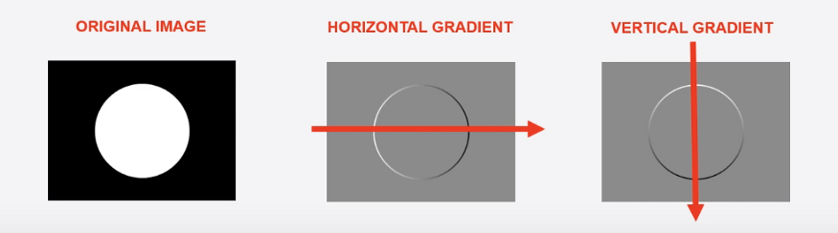
Histogram of Oriented Gradients(H.O.G)

Slide 32
H.O.G Continued
When you step from left to right pixel by pixel, you will find that after some steps, there is a sudden change in the pixel value i.e, from a black lower pixel number to a white higher pixel number. This sudden change in the color is called a gradient and going from a darker tone to a lighter tone is called a positive gradient and vice versa. Going from left to right gives us the horizontal gradient and as expected going from top to down gives a vertical gradient.

Slide 33
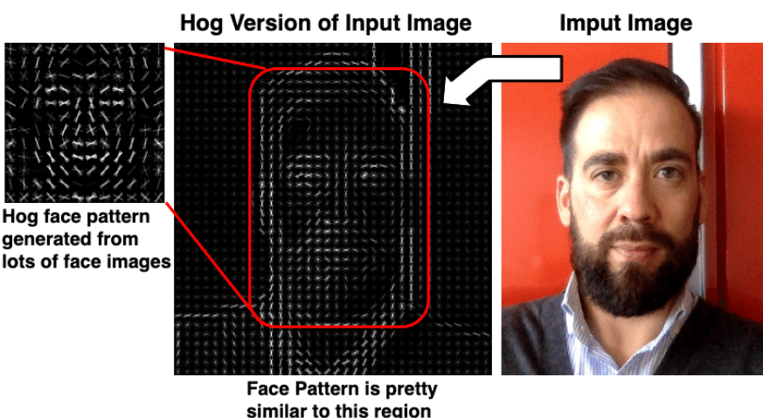
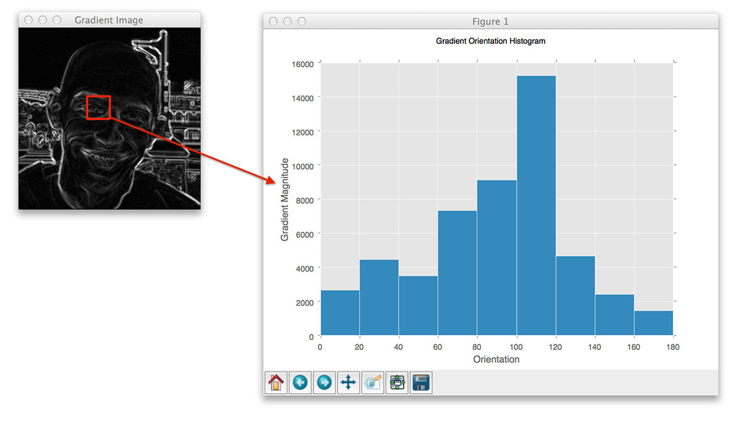
H.O.G. Continued

Slide 34
How H.O.G Works?
HOG works with something called a block which is similar to a sliding window. A block is considered as a pixel grid in which gradients are constituted from the magnitude and direction of change in the intensities of the pixel within the block.
NOTE: H.O.G works only with Gray Scale Images.

Slide 35
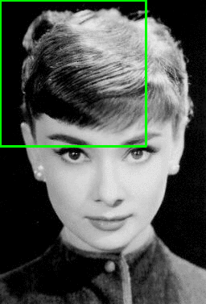
How H.O.G Works?(Continued)
Example of the sliding a window approach, where we slide a window from left-to-right and top-to-bottom.

Slide 36
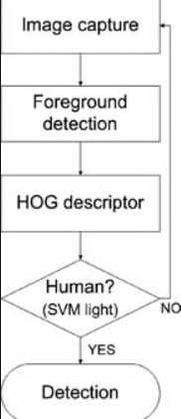
How H.O.G Works?(Continued)
Now, for our input image, this sliding window technique will be applied and for each window, the SVM(Support Vector Machine) classifier will be applied.
If the classifier incorrectly classifies a given window as an object, then that classification will be regarded as false-positive and will be given a very low probability value. This approach is called negative-hard mining.
After, the entire image is covered by the sliding window, the window with the highest probability is kept.
We will apply Non Max Suppression(NMS) to remove the redundant bounding boxes.

Slide 37
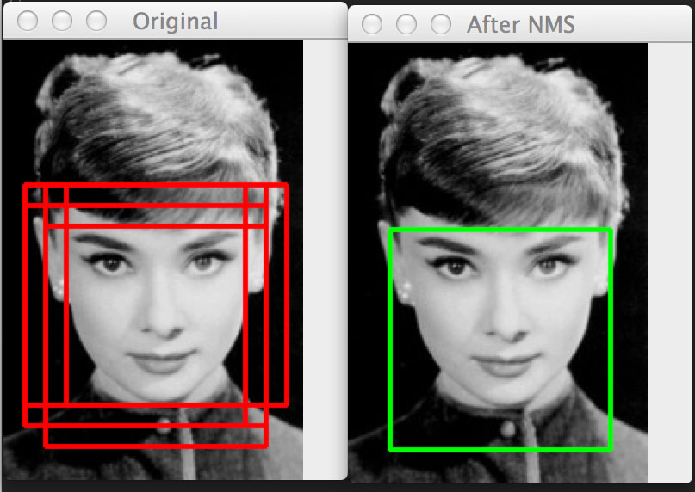
How H.O.G. Works?(Continued)

Slide 38
Confused?
We don’t need to worry about all these, the frontal face detector present inside dlib will handle all these. We just need to load the detector in our code.
The detector returns a rectangle object that comprises of all the co-ordinates of the sliding window having the highest probability.
This rectangle object will be sent to a function rect_to_bb(rect), that extracts the (x, y) coordinates and the height and width of the rectangle which will help us to draw the bounding box.

Slide 39
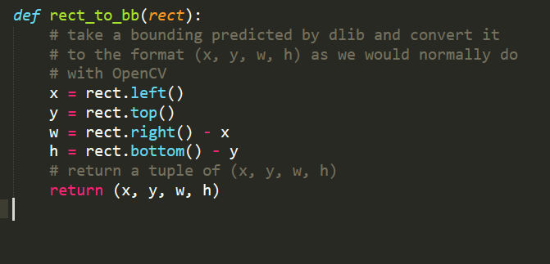
Drawing the Bounding Box
This rect_to_bb(rectangle) function is present in the imutils library and it looks like this:

Slide 40
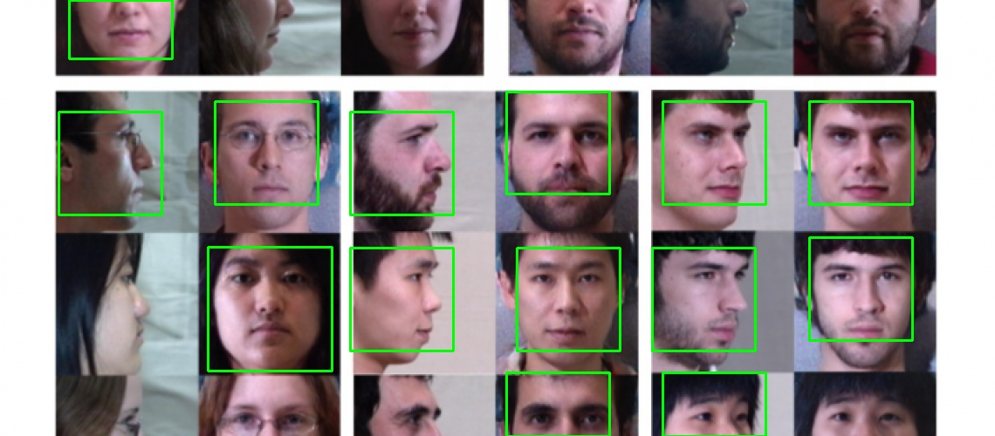
Results
Once the we get the coordinates of the rectangle, we draw it on the original image and the result will look like:

Slide 41
Time to Code!

Slide 42
Assignment
Try to implement, the system in real time, by streaming using web cam of the laptop/desktop.

Slide 43
References
https://towardsdatascience.com/cnn-based-face-detector-from-dlib-c3696195e01c
https://www.pyimagesearch.com/2017/04/03/facial-landmarks-dlib-opencv-python/
https://www.pyimagesearch.com/2014/11/10/histogram-oriented-gradients-object-detection/

Slide 44
Thank You!

